Slide 1





COMPUTATIONAL ENGINEERING MECHANICS
SUBJECT CODE – 19PHY104

Slide 2
GROUP NO - 12
MEMBERS | ROLL NO
S HARI SANKAR | AM.EN.U4AIE21056
R RAKESH | AM.EN.U4AIE21052
K SUBHASH | AM.EN.U4AIE21036
SAI MANASA SOUMYA | AM.EN.U4AIE21057
CHARISHMA AKSHAYA | AM.EN.U4AIE21051

Slide 3

PROBLEM - 1
The given figure is a real life example of bridge trusses. There's a vehicle with load 81 kN. Due to the weight of the car the load at points L and K of the bridge truss is of magnitude 40.5 kN. With the help of method of joints and sections analyze the forces in AN ,AB ,NM,MC, NB , BM, BC, CL, DE, DK by finding out the forces on each truss members. Using MATLAB
Get the load of the vechile and draw the graph of force variation with the load from 1kN to the given value
Get the angle of the bridge and load from user and draw the graph between angle and force variation.
Get the maximum truss force supported from the user and give the max load supported in the truss

Slide 5
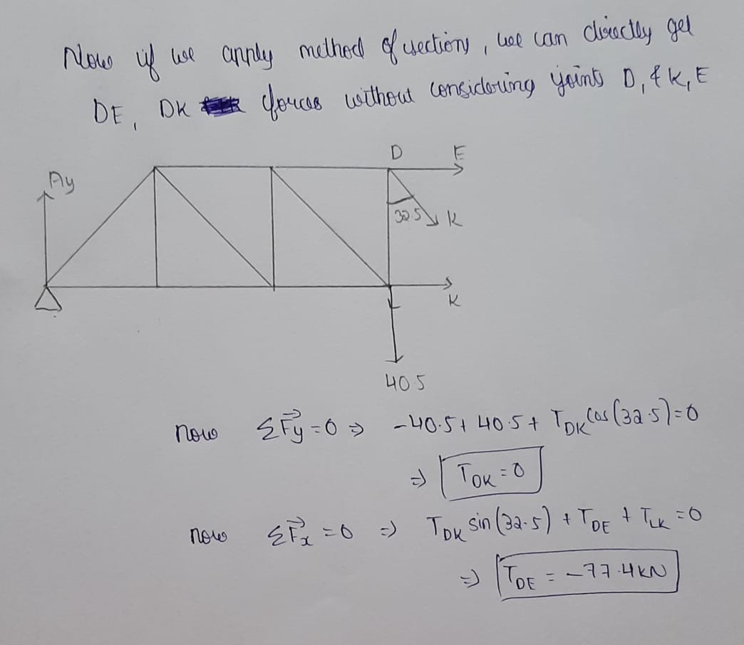

Slide 6
MATLAB
figure
plot(y,BM);
title("Variation of force in BM with load");
xlabel("load in kN");
ylabel("Truss force in kN");
%Code for bridge truss 1
disp("Enter what would you like to do ")
disp("1.variation of truss forces with load")
disp("2.variation of truss forces with load and angle ")
disp("3.find out the max load by giving the max truss force bearable ")
n=input("Enter the choice ");
switch n
case 1
P=input("Enter the load of the vechile ");
p=P/2;
x=floor(p);
AN=0:x;
BM=0:x;
MC=0:x;
BC=0:x;
DE=0:x;
y=0:x;
for i=0:x
AN(1,i+1)=i*cotd(57.5);
BM(1,i+1)=i*cscd(57.5);
MC(1,i+1)=i;
BC(1,i+1)=-2*i*cotd(57.5);
DE(1,i+1)=-3*i*cotd(57.5);
end
figure
plot(y,AN);
title("Variation of force in AN with load");
xlabel("load in kN");
ylabel("Truss force in kN");
figure
plot(y,BC);
title("Variation of force in BC with load");
xlabel("load in kN");
ylabel("Truss force in kN");
figure
plot(y,DE);
title("Variation of force in DE with load");
xlabel("load in kN");
ylabel("Truss force in kN");
case 2
%Matlab code for part 2
t = input("Enter the angle BAN ");
P=input("Enter the load of the vechile ");
p=P/2;
AN=1:t;
BM=1:t;
BC=1:t;
DE=1:t;
y=1:t;
for i=1:t
AN(1,i)=p*cotd(i);
BM(1,i)=p*cscd(i);
BC(1,i)=-2*p*cotd(i);
DE(1,i)=-3*p*cotd(i);
end

Slide 7
figure
plot(y,BM);
title("Variation of force in BM with angle ");
xlabel("angle in degrees ");
ylabel("Truss force in kN");
figure
plot(y,BC);
title("Variation of force in BC with angle ");
xlabel("angle in degrees ");
ylabel("Truss force in kN");
figure
plot(y,DE);
title("Variation of force in DE with angle ");
xlabel("angle in degrees ");
ylabel("Truss force in kN");
case 3
m=input("Enter the max truss force each of the truss can bear ");
p=m/(3*cotd(57.5));
disp("The maximum load the bridge can bear in kN is ")
disp(2*p)
end
CONCEPTS USED IN THE QUESTION
1.VECTORS AND COMPONENTS OF VECTORS
2.SUPPORTS AND SUPPORT REACTION
3.FORCE EQUILIBRIUM
4.METHOD OF JOINTS
5.METHOD OF SECTIONS

Slide 8
OUTPUT

Slide 11
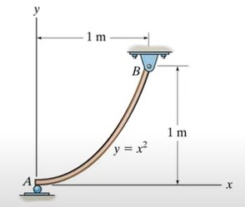
PROBLEM - 2
Q. A rod with two supports are given in the question. The rod induces a function of y=x^2 as shown in the figure. The support at A is a roller support whereas at B is a hinge support. Given weight per unit length is 100. Based on the data given in the figure-
A)Determine the vertical reaction at A and B
B)locate the center of gravity
C)Using matlab make the x coordinate of B point as a user input find out the location of centre of gravity
D)Using matlab plot the graph of variation of location of centre of gravity with x coordinate of b
E)Using matlab get the weight per unit length from the user and calculate the support reactions
F)Using matlab plot the variation of support reactions with weight per unit length

Slide 12
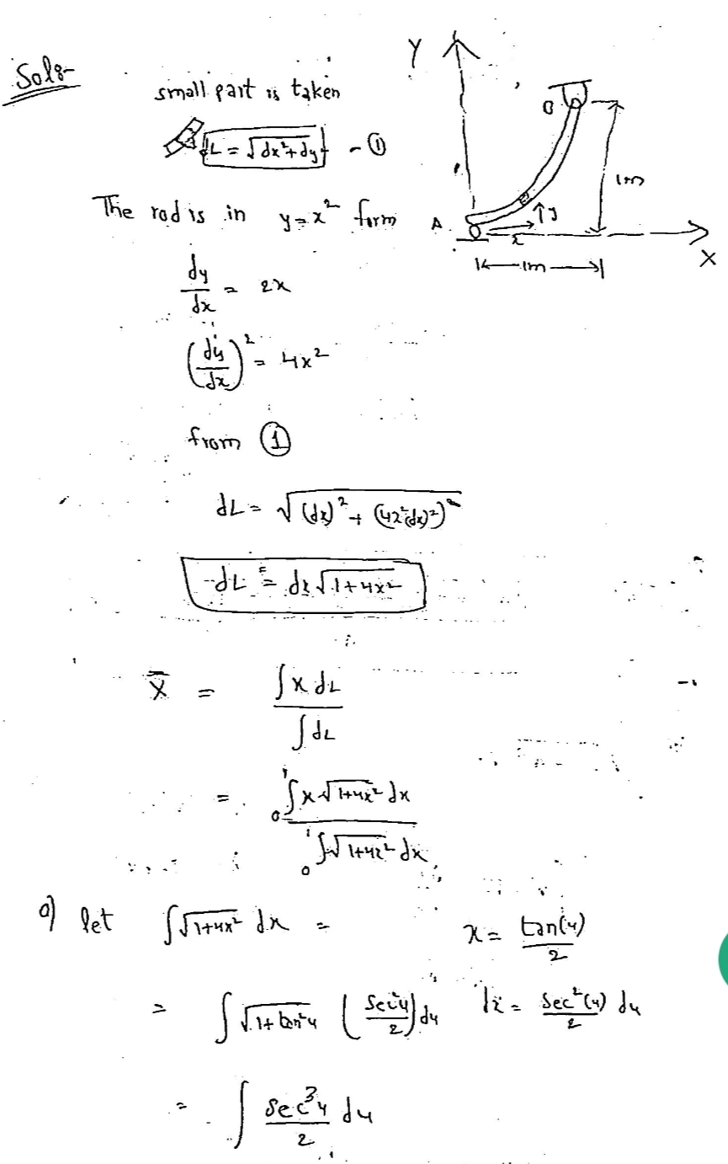
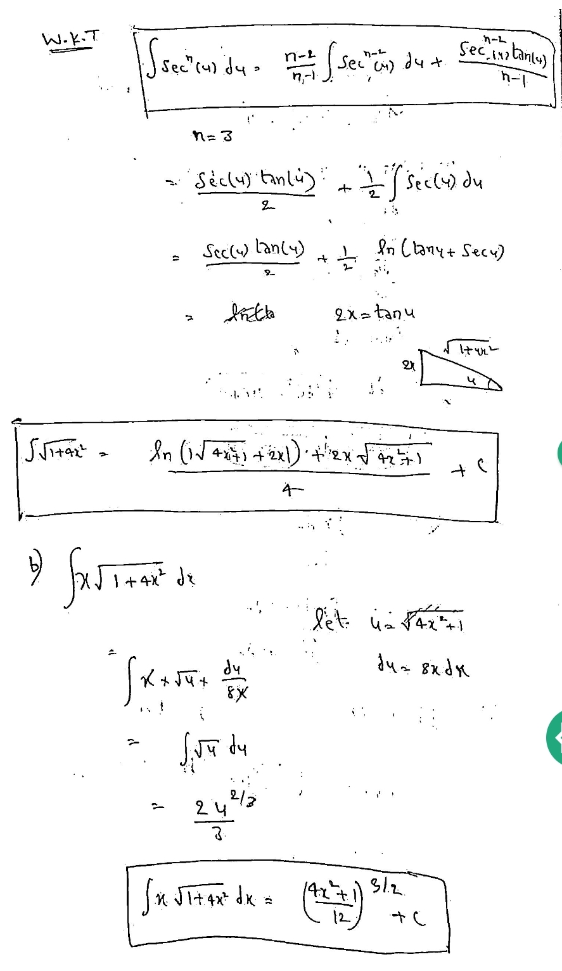
THEORITICAL CALCULATIONS

Slide 13
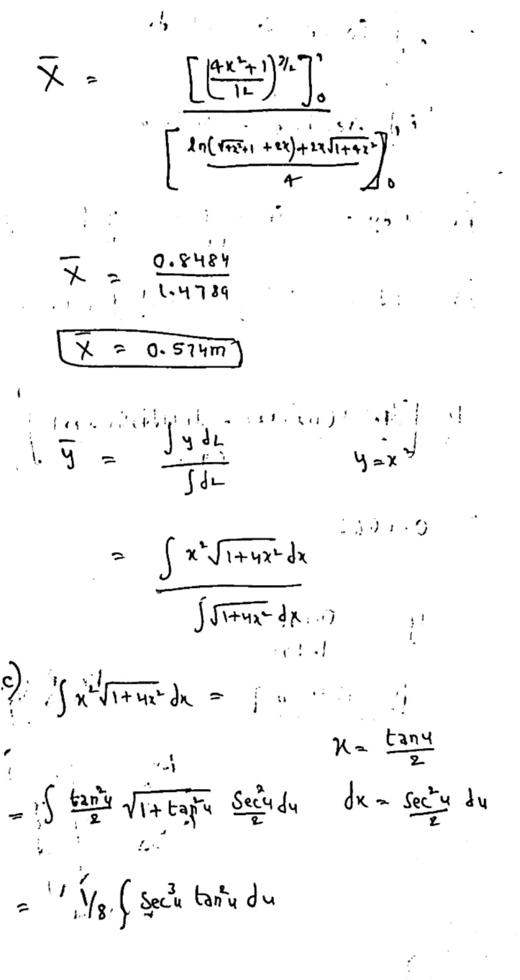
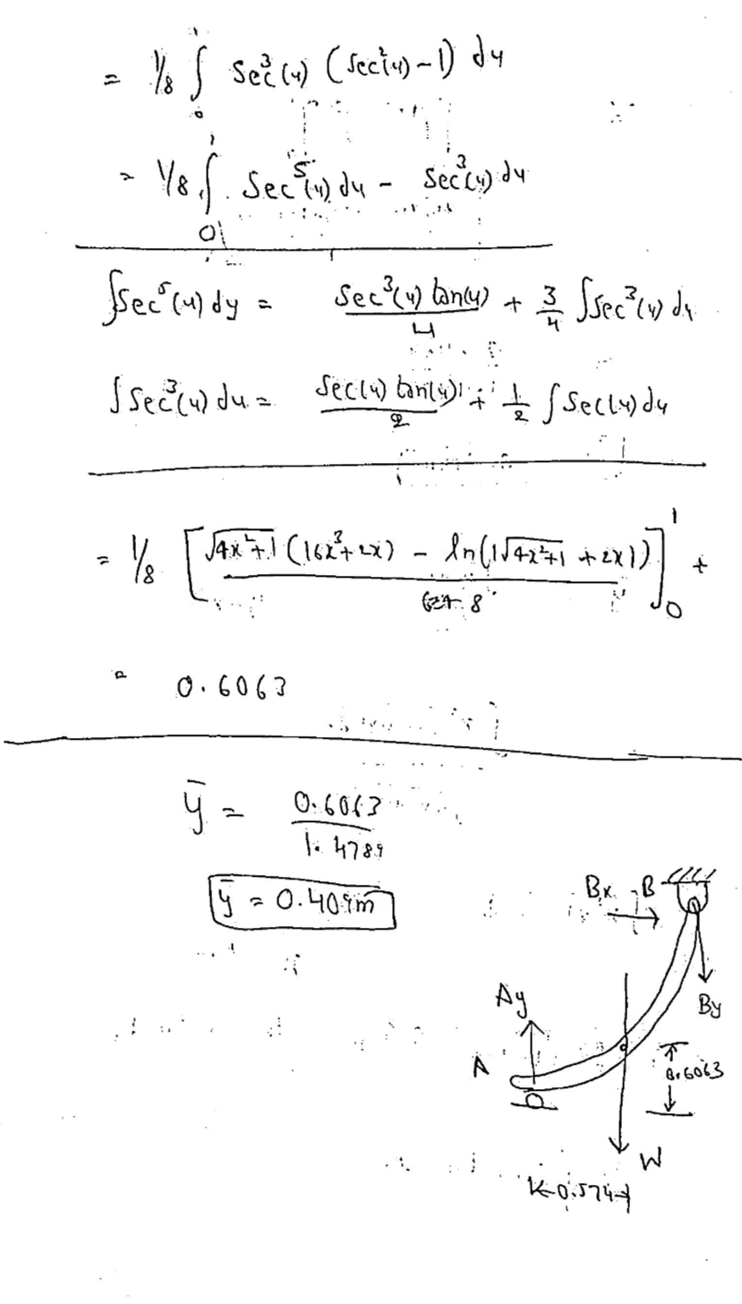

Slide 14
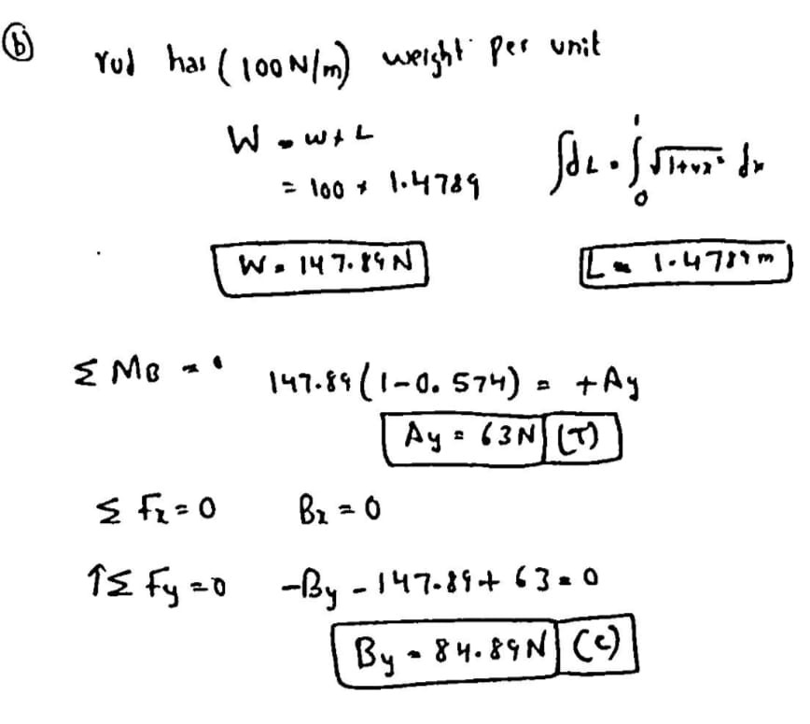

Slide 15
MATLAB
%MATLAB PART FOR THE 1ST QUESTION
in = 'input the value of x coordinate of B';
x = input(in);
X1 = ((((4*(x^2))+1)^1.5)/12)-0.0833;
X2 = (log((4*(x^2) +1)^0.5+(2*x))+(2*x*((4*(x^2) +1)^0.5)))/4;
Xcm=X1/X2;
Y1=(((4*(x^2) +1)^0.5).*(16*(x^3) + 2*x)-log((4*(x^2) +1)^0.5 +2*x))/64;
Y2 = (log((4*(x^2) +1)^0.5+2*x)+(2*x*((4*(x^2) +1)^0.5)))/4;
Ycm= Y1/Y2;
disp("The value of Xcom is ")
disp(Xcm)
disp("The value of Ycom is ")
disp(Ycm)
e=1:x;
xc=1:x;
yc=1:x;
for i=1:x
X1 = ((((4*(i^2))+1)^1.5)/12)-0.0833;
X2 = (log((4*(i^2) +1)^0.5+(2*i))+(2*i*((4*(i^2) +1)^0.5)))/4;
xc(1,i)=X1/X2;
Y1=(((4*(i^2) +1)^0.5).*(16*(i^3) + 2*i)-log((4*(i^2) +1)^0.5 +2*i))/64;
Y2 = (log((4*(i^2) +1)^0.5+2*i)+(2*x*((4*(i^2) +1)^0.5)))/4;
yc(1,i)=Y1/Y2;
end

Slide 16
figure;
plot(e,xc)
title("The variation of XCOM with x cordinate of b")
xlabel("X coordinate of B ")
ylabel("XCOM coordinate ")
figure;
plot(e,yc)
title("The variation of YCOM with x cordinate of b")
xlabel("X coordinate of B ")
ylabel("YCOM coordinate ")
%MATLAB CODE FOR 2ND PART
in = 'input the value of x coordinate of B';
x = input(in);
X1 = ((((4*(x^2))+1)^1.5)/12)-0.0833;
X2 = (log((4*(x^2) +1)^0.5+(2*x))+(2*x*((4*(x^2) +1)^0.5)))/4;
Xcm=X1/X2;
Y1=(((4*(x^2) +1)^0.5).*(16*(x^3) + 2*x)-log((4*(x^2) +1)^0.5 +2*x))/64;
Y2 = (log((4*(x^2) +1)^0.5+2*x)+(2*x*((4*(x^2) +1)^0.5)))/4;
Ycm= Y1/Y2;
L=(log((4*(x^2) +1)^0.5+(2*x))+(2*x*((4*(x^2) +1)^0.5)))/4;

Slide 17
W=input("Enter the weight per unit length ");
ay=1:W;
by=1:W;
w=1:W;
t=L*W;
AY=t*(x-Xcm);
BY=AY-t;
disp("AY is ")
disp(AY)
disp("BY is ")
disp(BY)
for i=1:W
t=L*i;
ay(1,i)=t*(x-Xcm);
by(1,i)=(ay(1,i))-t;
end
figure;
plot(w,ay)
title("The variation of AY with Weight per unit length")
xlabel("Weight per unit length ")
ylabel("AY in N ")
figure;
plot(w,by)
title("The variation of BY with Weight per unit length")
xlabel("Weight per unit length ")
ylabel("BY in N ")

Slide 18
OUTPUT

Slide 19
CONCEPTS USED IN THE QUESTION
1.CENTROID
3CENTRE OF GRAVITY
3.FORCE EQUILIBRIUM
4.SUPPORTS AND SUPPORT REACTIONS

Slide 20
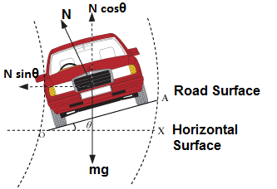
PROBLEM - 3
There is a curved road of radius 24m banked with an inclination theta 21 degrees present in a road. A car of mass 50 kg rides through
a. Find the frictional force acting on the car if the velocity with which the car moves is 8m/s. Also derive the formulae for max velocity and angle of banking for a given mass M of the car?
b. Using MATLAB plot the variation of frictional force and mass from 1 to M kg?
c. Using MATLAB take the input from user for different parameters and find the max velocity of the car?
d. Using MATLAB plot the variation of Banking Angle theta and the max velocity after taking the input from the user?

Slide 21
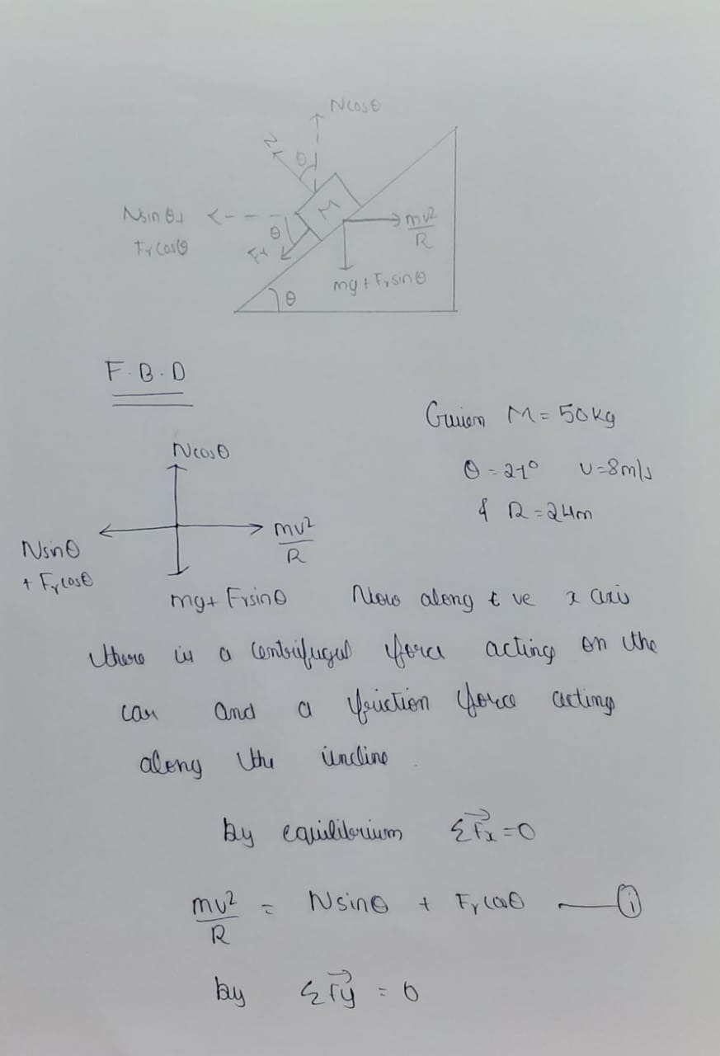
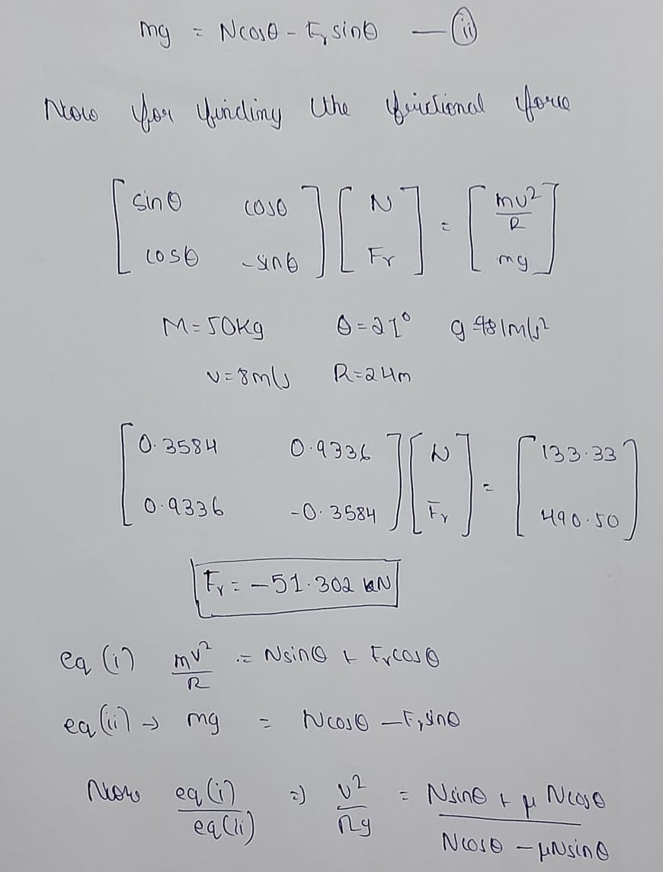
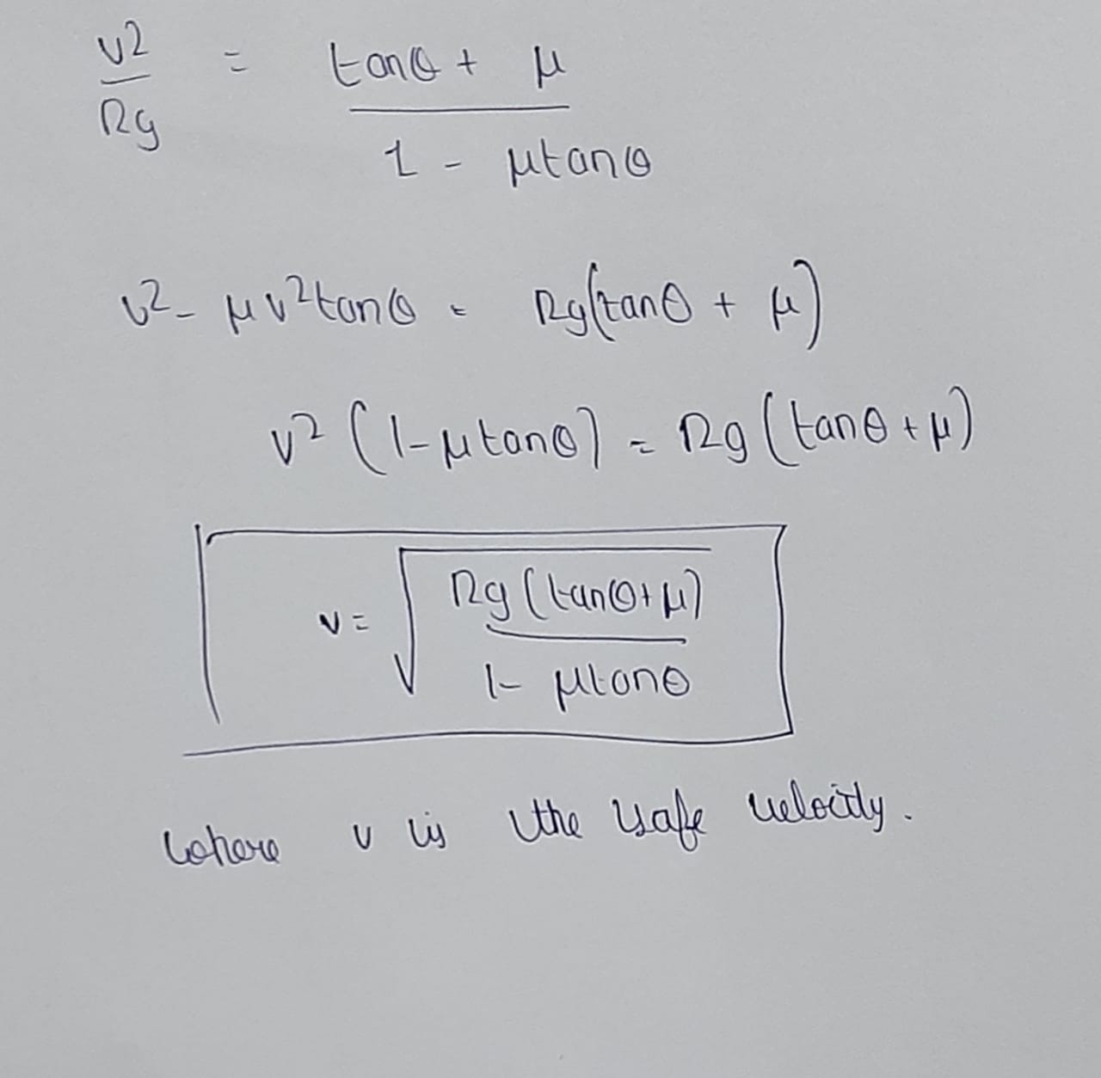
THEORITICAL CALCULATIONS

Slide 22
MATLAB
for m1=1:m
b=[(m1*(v.^2)/r);(m1*9.81)];
x=inva*b;
x2=x(2,1);
x1(1,m1)=x2;
end
m1=1:m;
plot(m1,x1)
title("Variation of friction with mass of the car");
xlabel("Mass in kg");
ylabel("Friction in N");
case 2
%Velocity max when theta and coefficient of friction is given
t=input("Enter the the inclination angle in degrees ");
r=input("Enter the radius of curve ");
m=input("Enter the mass of the car ");
u=input("Enter the friction coefficient of the road ");
num=r*9.81*(tand(t)+u);
deno=(1-(u*tand(t)));
fr=num/deno;
v=sqrt(fr);
disp("The max velocity with which car should be moved is ")
%Friction in banking of roads
disp("Enter the action required to do ")
h=input("1.FINDING FRICTIONAL FORCE 2.FINDING VMAX 3.FINDING ANGLE OF BANKING")
switch h
case 1
m=input("Enter the mass of the car ");
t=input("Enter the the inclination angle in degrees ");
v=input("Enter the velocity of the car ");
r=input("Enter the radius of curve ");
a=[sind(t) cosd(t);cosd(t) -sind(t)];
inva=inv(a);
b=[(m*(v.^2)/r);(m*9.81)];
x=inva*b;
x1=1:m;
disp("The frictional force acting is ")
disp(x(2,1))

Slide 23
disp(v)
case 3
%angle of banking when max velocity and radius is given and graph
u=input("Enter the friction coefficient of the road ");
r=input("Enter the radius of curve ");
v=input("Enter the max velocity of the car ");
num=1-u;
deno=(v*v*u/(r*9.81))+1;
t=atand((num/deno));
disp("The inclination angle is ")
disp(t)
v1=1:v;
t1=1:v;
for v2=1:v
num=1-u;
deno=(v2*v2*u/(r*9.8))+1;
t1(1,v2)=atand((num/deno));
end
figure;
plot(v1,t1)
title("Variation of banking angle with max veloity of the car");
CONCEPTS USED IN THE QUESTION
1. VECTORS AND COMPONENTS OF VECTORS
2. FRICTION
3. FORCE EQUILIBRIUM
4. CENTREPETAL FORCES
xlabel("velocity in m/s");
ylabel("theta in degrees");
end

Slide 24
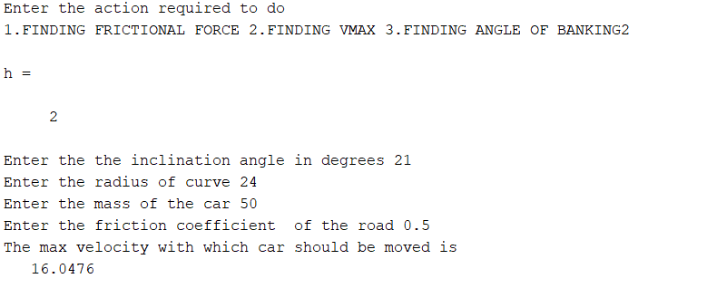
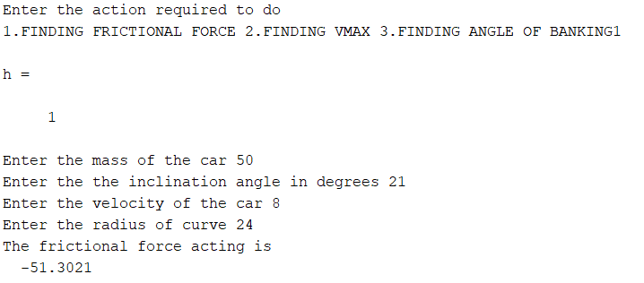
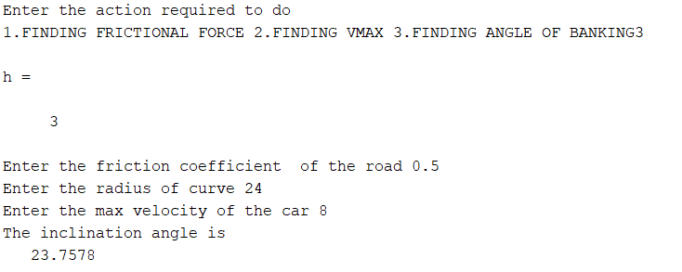
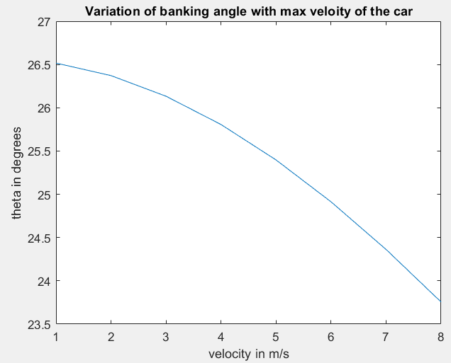
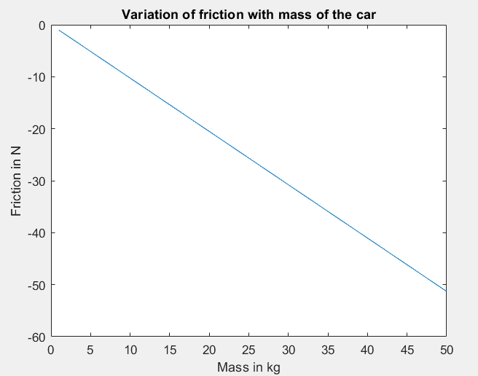
OUTPUT

Slide 25
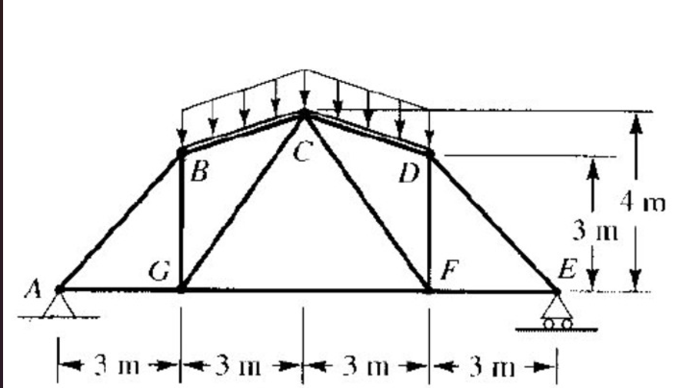
PROBLEM - 4
Roof trusses are examples of truss structures in our everyday life. During winter, snow loads up at the roof causing a load 3x + 5 on the points B,C AND D where x is the a specific day of winter. eg. On the 27th day of winter, x will be 27N. And there is a constant snow fall for 30 days.
a) If the max stress force which can maintained by any truss is 140N, find upto how many days in the winter will the roof truss be able to support the house and draw the graph upto the day at which the truss fails.
b) The angle theta is inputted from the user for the load of x N on points B, C and D and then to find the variation of forces in AB,AG from theta = 1 to given value. (ie. Ignore the dimensions in the figure)

Slide 26
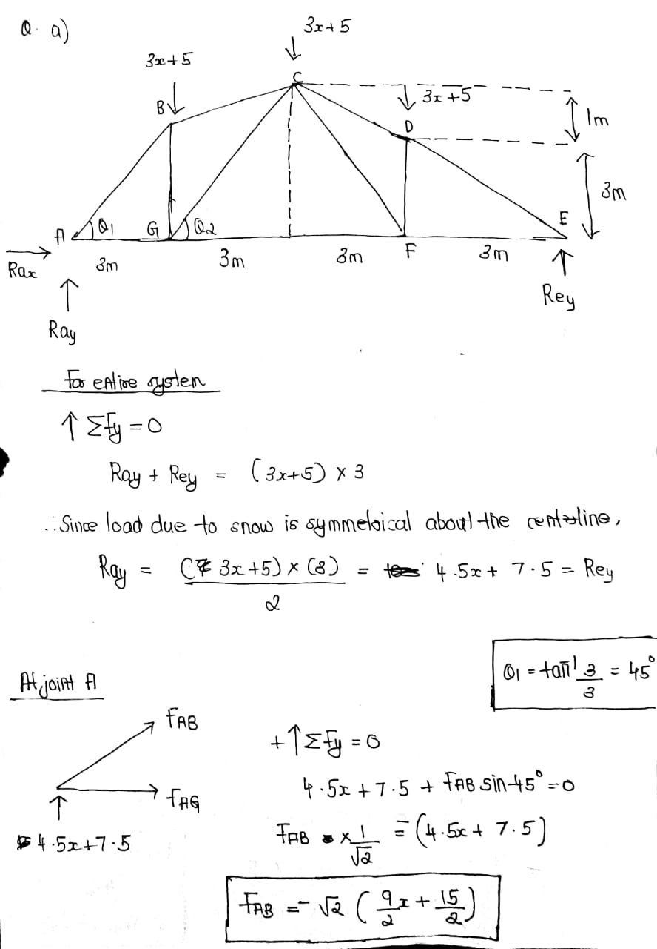
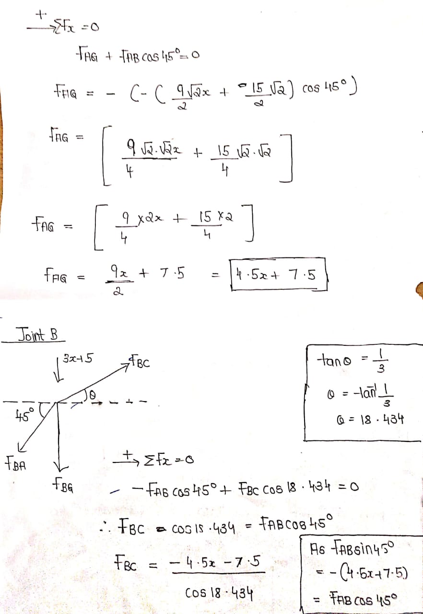
THEORITICAL CALCULATIONS

Slide 27
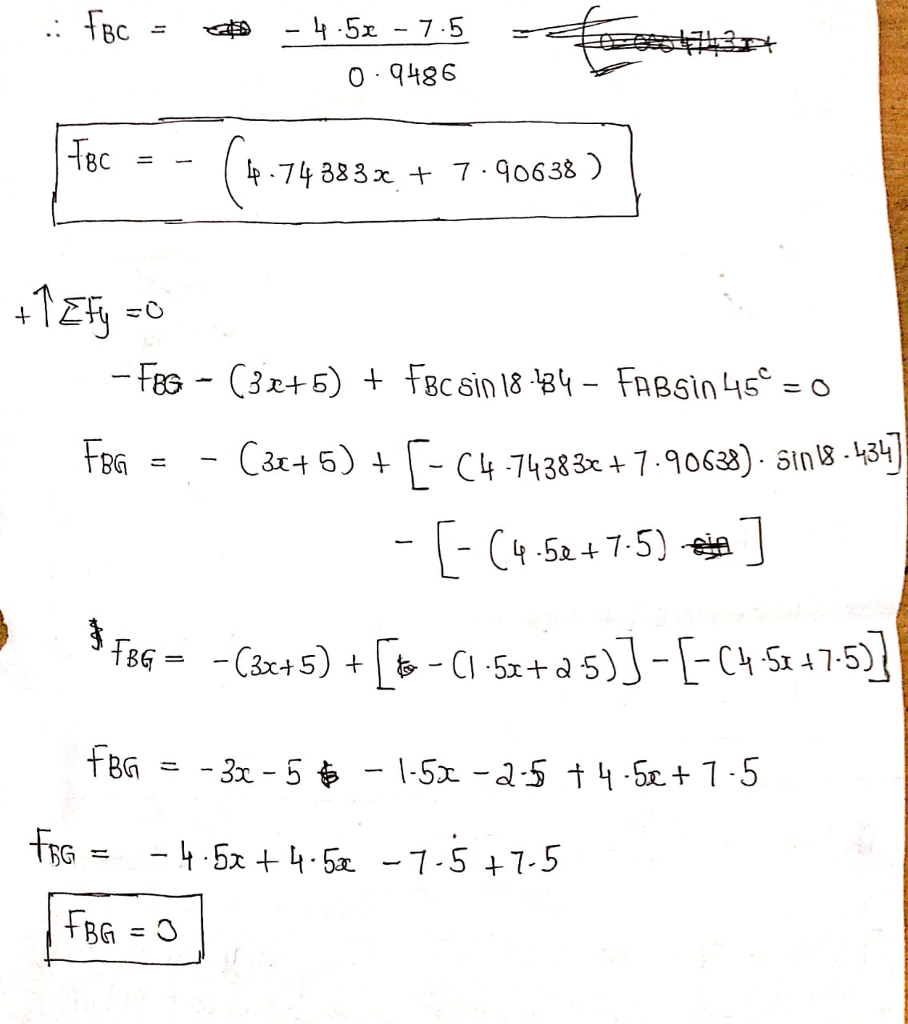
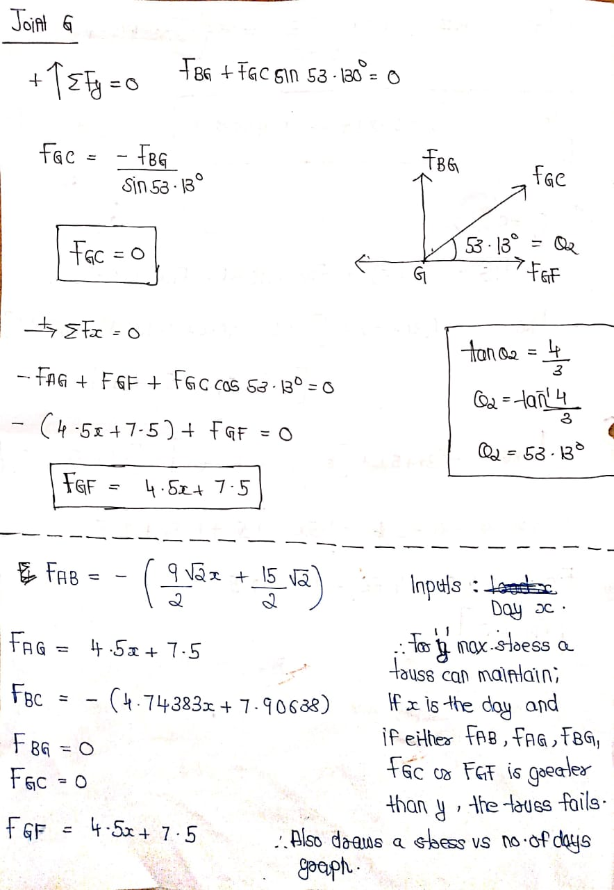

Slide 28
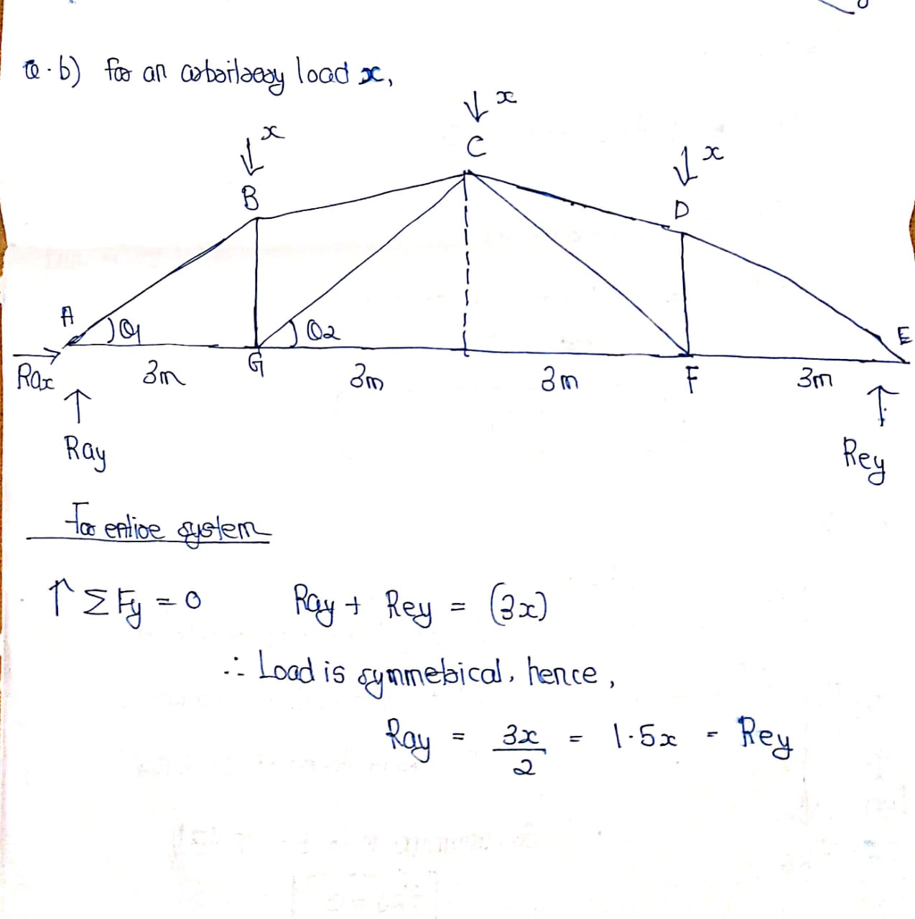

Slide 29
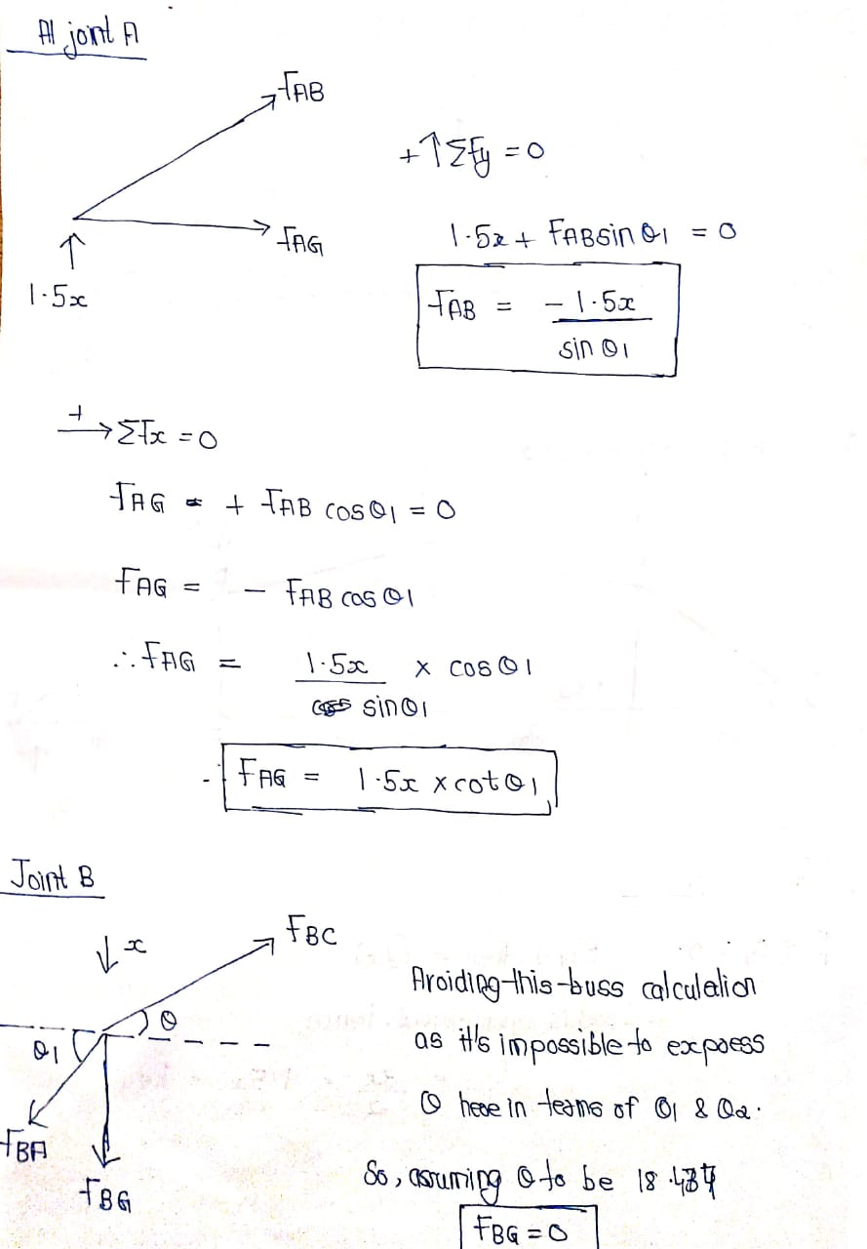
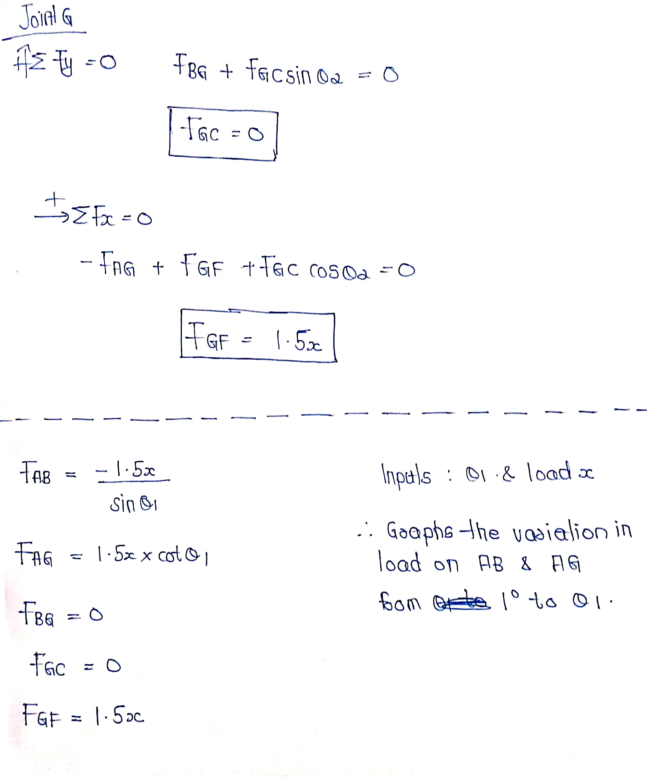

Slide 30
MATLAB
disp("Snow Fall has begun. It will continue for 30 Days. Maximum Stess maintained by any truss is 140N. Enter your choice below: ");
a = input("1. For an arbitrary day 'X' after snow fall has begun, find if the truss would fail." + newline + "2. For an arbitrary load 'x' on B,C & D, Enter the angle 'Θ'(∠CGF in the fig. ; in degress) and plots the variation of load on AB & AG from 1° to 'Θ' " + newline + "Enter your choice: ");
s = sqrt(2);
switch a
case 1
disp("Enter the day 'X' for which the stress on the trussess due to snow is calculated and graph is plotted.")
x = input("Enter X (0 to 30): ");
fab = ((9/s)*(x) + 15/s); %Compression ; Taken Negative to get the positive value. Fab will always fail first.
fag = (4.5)*(x) + 7.5;
fbc = (4.74383)*(x) + 7.90638; %Compression ; Taken Negative to get the positive value.
fbg = 0;
fgc = 0;
fgf = (4.5)*(x) + 7.5;
Main = [fab fag fbc fbg fgc fgf];
Main2 = Main > 140;
Main3 = any(Main2);
if Main3==true
disp("*****The Roof Truss has failed for the given day X.*****");
else
disp("***The Roof Truss has not failed for the given day X.***")
end
Main4 = [];
for i = 1:21
fmain = ((9/s)*(i) + 15/s);
Main4(end+1)=fmain;
end

Slide 31
x1=1:21;
y1=Main4;
ln = plot(x1,y1);
xlabel('Days')
ylabel('Force On Truss AB(N)')
title('Days Vs Force(C/T) On Truss AB(N)')
xticks(1:21);
yticks(Main4);
xtickangle(45)
ln.LineWidth = 2;
ln.Color = [0 0.5 0.5];
ln.Marker = 'o';
ln.MarkerEdgeColor = 'b';
case 2
x2 = input("Enter Load 'X' on B,C & D(N) : ");
theta = input("Enter 'Θ'(∠CGF in the fig. ; in degress): ");
fab2 = ((-1.5)*(x2)/(sin(theta)));
fag2 = ((1.5)*(x2)*(cot(theta)));
Main5 =[];
Main6=[];
for i = 1:theta
fab2main = -((-1.5)*(i)/(sin(theta)));
fag2main = ((1.5)*(i)*(cot(theta)));
Main5(end+1)=fab2main;
Main6(end+1)=fag2main;
End
x3 = 1:theta;
y3 = Main5;
ln1 = plot(x3,y3);
xlabel("Theta (in degrees)")
ylabel("Forces On AB and AG(N)")
title("Variation Of Forces On AB and AG w.r.t the angle 'Θ'(∠CGF in the fig.)")
xtickangle(45)
ln1.LineWidth = 2;
ln1.Color = [0 0.5 0.5];
ln1.Marker = 'o';
ln1.MarkerEdgeColor = 'b';
hold on
y4 = Main6;
ln2= plot(x3,y4);
legend('AB','AG')
ln2.LineWidth = 2;
ln2.Color = [0 0.5 0.5];
ln2.Marker = 'o';
ln2.MarkerEdgeColor = 'r';
end
CONCEPTS USED IN THE QUESTION
1.VECTORS AND COMPONENTS OF VECTORS
3.METHOD OF JOINTS
3.FORCE EQUILIBRIUM
4.SUPPORTS AND SUPPORT REACTIONS

Slide 32
OUTPUT

Slide 34
PROBLEM - 5
A gasoline engine producing 150 Nm of torque is used to drive a winch and lift a weight. In the figure the winch drum has a radius of 0.25 m and it is driven from the engine via 1:50 speed reduction gear(speed reduction = W(winch)/.
What mass could be raised with system assuming that mass moves with a constant velocity?
Using matlab get the torque from the user and the reduction ratio from the user and plot the variation of max weight lifted up by the engine and the torque provided by the engine?
Using matlab get the radius of the winch from the user and plot the graph between maximum weight lifted and radius?

Slide 35
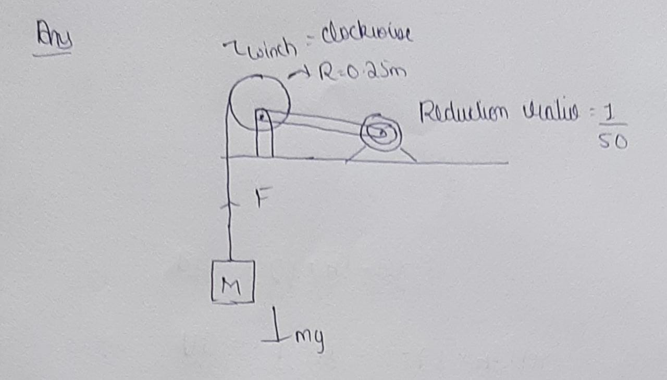
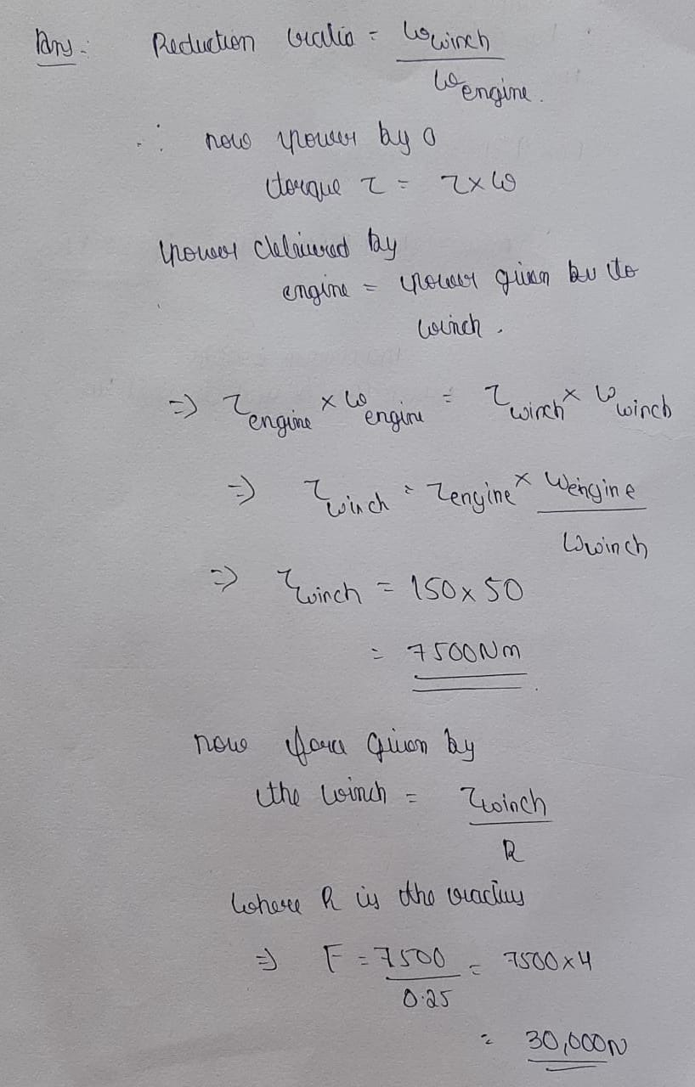
THEORITICAL CALCULATIONS

Slide 36
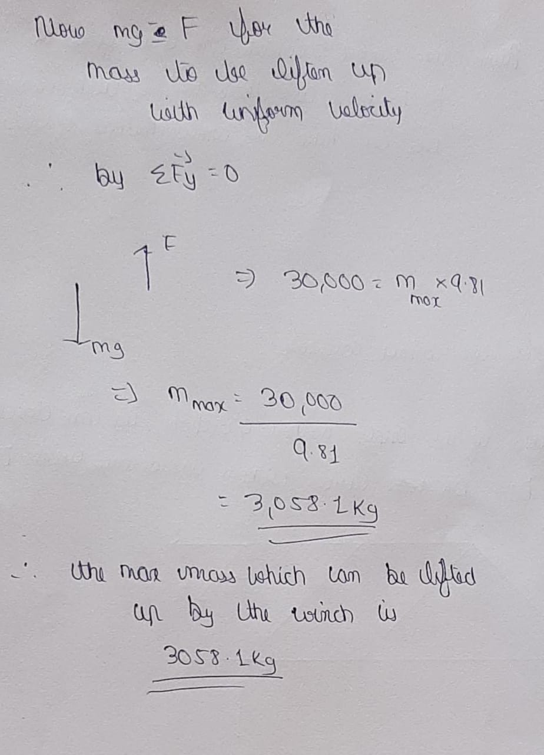

Slide 37
MATLAB
%MATLAB PART FOR QUESTION 1
T=input("Enter the torque provided by the engine ");
R= input("Enter the reduction ratio of the engine ");
M=T/(R*0.25*9.81);
disp("The max mass lifted up is ")
disp(M);
M1=1:T;
A=1:T;
for i = 1:T
M1(1,i)=i/(R*0.25*9.81);
end
plot(A,M1)
title("variation of max weight lifted up by the torque to the torque provided by the engine ")
xlabel("Torque in Nm ")
ylabel("mass in kg")
%MATLAB PART FOR QUESTION 2
T=input("Enter the torque provided by the engine ");
R= input("Enter the reduction ratio of the engine ");
r=input("Enter the radius of the winch ");
a=1:r;

Slide 38
M2=1:r;
for i= 1:r
M2(1,i)=T/(R*i*9.81);
end
figure;
plot(a,M2)
title("variation of max weight lifted up by the torque to the radius of the winch ")
xlabel("Torque in Nm ")
ylabel("mass in kg")

Slide 39
OUTPUT

Slide 40
CONCEPTS USED IN THE QUESTION
1.TORQUE
2.POWER PRODUCED BY A TORQUE
3.FORCE EQUILIBRIUM

Slide 41
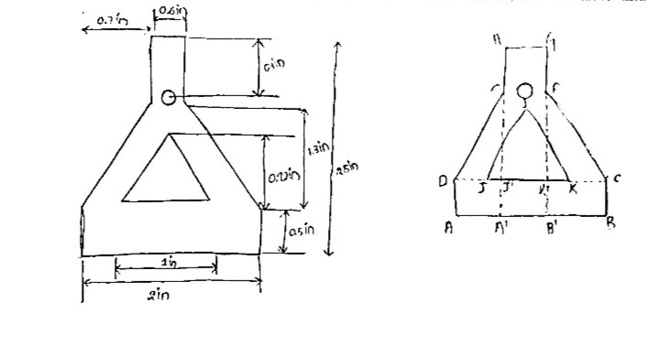
PROBLEM - 6
A Complex structure is given below. The total height of the structure is 2.5 inch. The base length of the structure is 2 inch. Find out the moment of inertia of the given structure with respect to an axis passing through the centroid of the figure. Using matlab-
Get the base as an input from the user and find out the moment of inertia of the figure with respect to the x axis
Plot a variation of the moment of inertia of the structure with respect to the x axis with the variation of base from 1 to the given input

Slide 42
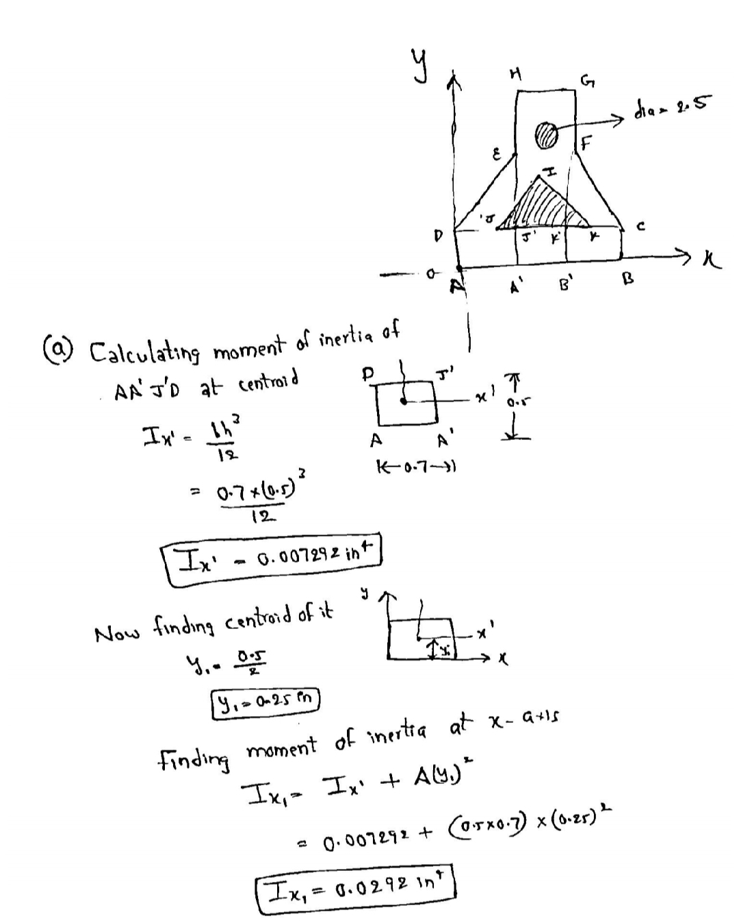
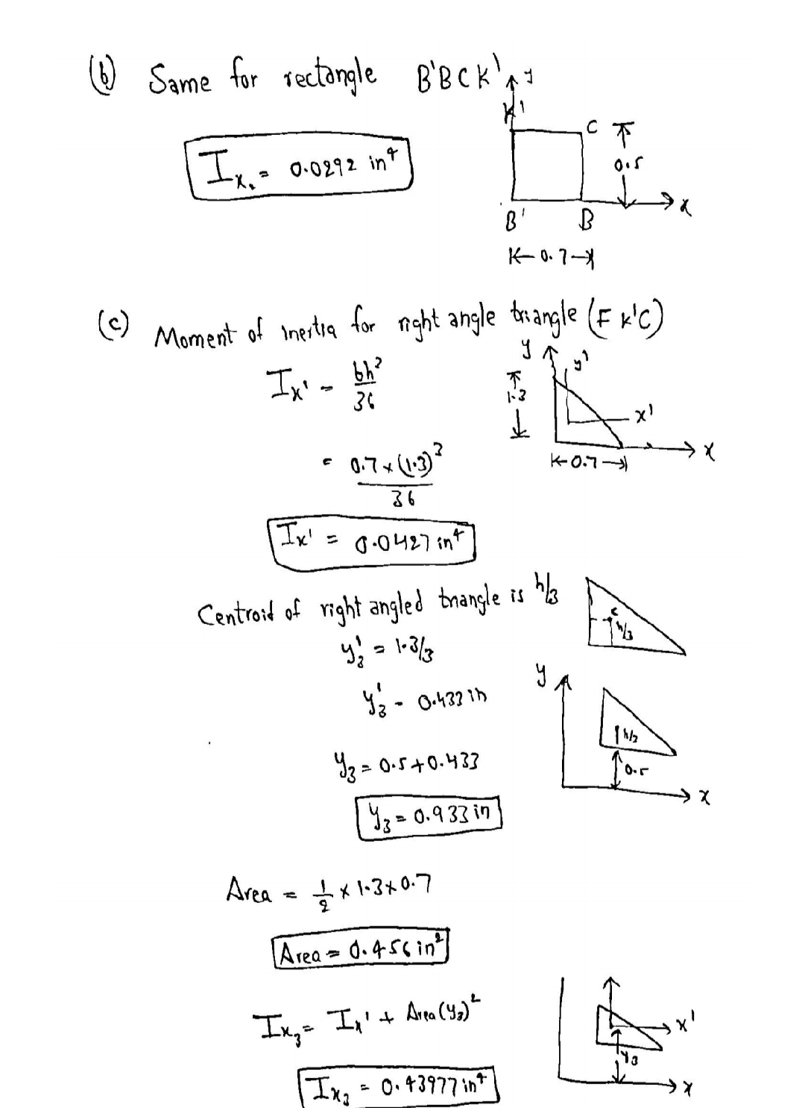
THEORITICAL CALCULATIONS

Slide 43
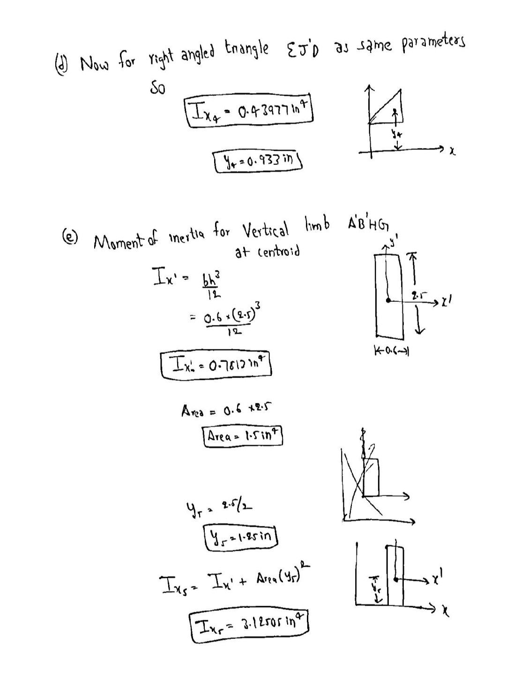
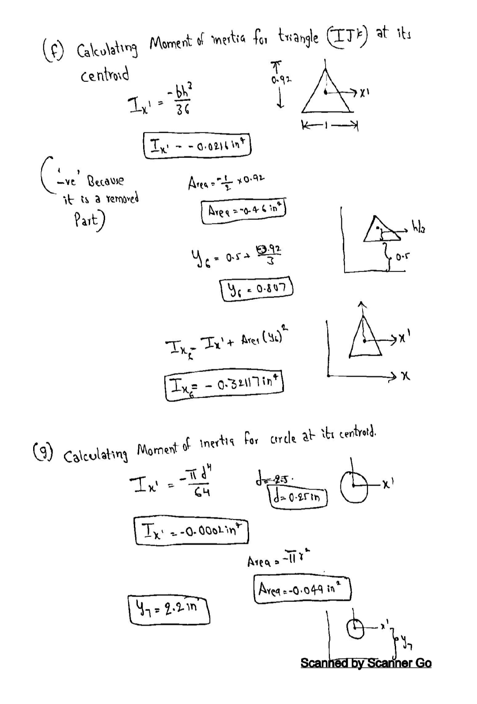

Slide 44
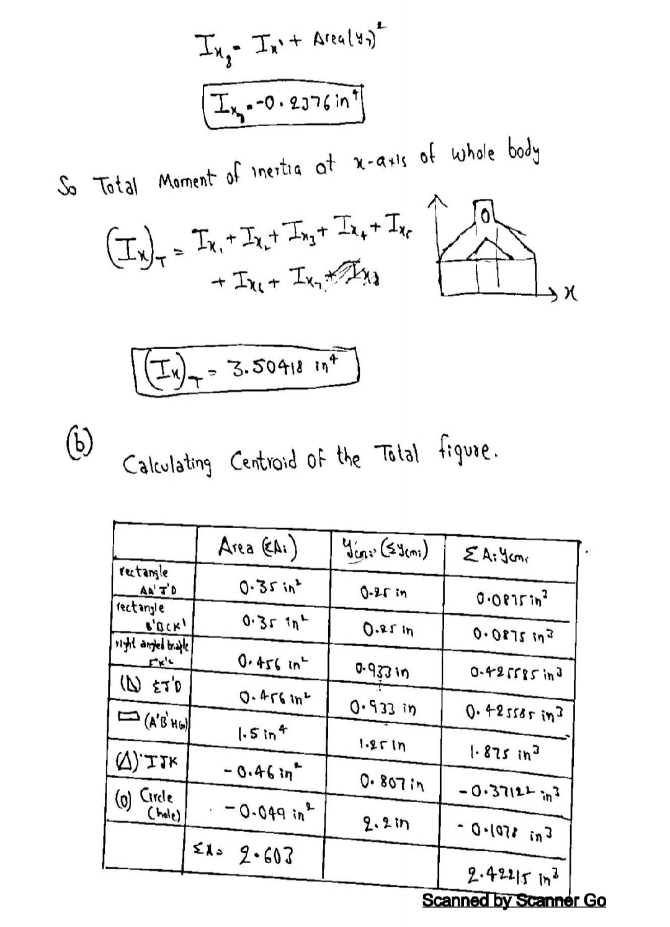
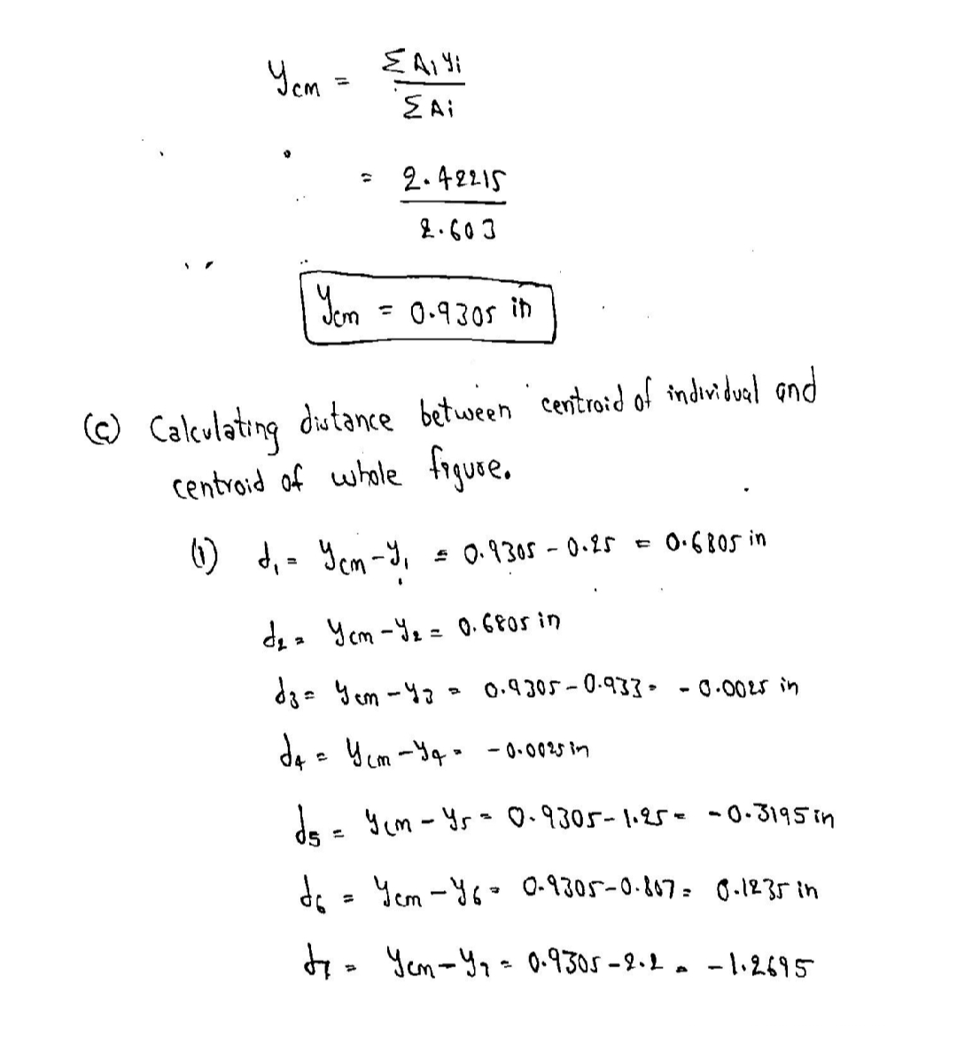

Slide 45
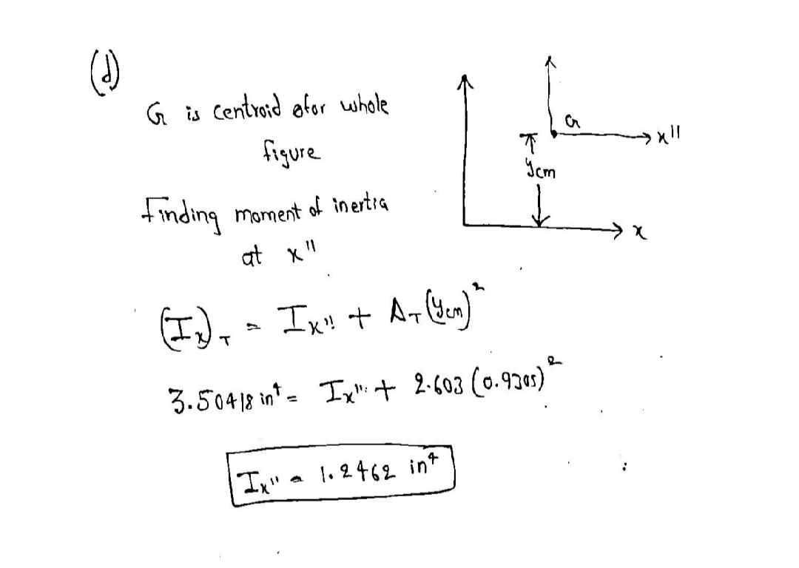

Slide 46
MATLAB
b=input("Enter the base length ")
A1=(1.3*(b-0.6))/4; %right angled triangle area
I1=((b-0.6)/2)*(1.3^3)/36; %right angled triangle moment of inertia wrt centroid
dy1=(1.3/3)+0.5;%right angled triangle distance of centroid from x axis
X1=(dy1^2);
S1=(A1*(X1))+I1;%right angled triangle moment of inertia wrt x axis
A2=((b-0.6)*0.5/2); %2 small rectangles area
I2=((b-0.6)/2*(0.5^3))/12; % 2 small rectangles on the base moment of inertia wrt centroid
dy2=0.25;% 2 small rectangles on the base distance of centroid from x axis
X2=(dy2^2);
S2=(A2*(X2))+I2; % 2 small rectangles on the base moment of inertia wrt x axis
A3 = 1.5; % BIG RECTANGLE area
dy3=1.25; % BIG RECTANGLE moment of inertia wrt centroid
I3=(0.6*(2.5^3))/12 % BIG RECTANGLE distance of centroid from x axis
X3=(dy3^2);
S3=(A3*(X3))+I3;% BIG RECTANGLE moment of inertia wrt x axis

Slide 47
A4 = (3.14*(0.125)^2); %hollow circle area
dy4 = 2.2; %hollow circle moment of inertia wrt centroid
I4 = (3.14*(0.25^4))/64; %hollow circle distance of centroid from x axis
X4=(dy4^2);
S4=(A4*(X4))+I4; %hollow circle moment of inertia wrt x axis
A5=(0.92/2); %hollow TRIANGLE area
dy5=(0.5+(0.92/3)); %hollow TRIANGLE distance of centroid from x axis
I5=((0.92^3)/36); %hollow TRIANGLE moment of inertia wrt centroid
X5=(dy5^2);
S5=(A5*(X5))+I5; %hollow TRIANGLE moment of inertia wrt x axis
S=(2*S1)+(2*S2)+(S3)-S4-S5;%final moment of inertia
disp("The moment of inertia with respect of x axis is ")
disp(S) disp("The moment of inertia with respect of x axis is ")
disp(S)
m1=1:b;
a=1:b;

Slide 48
for i=1:b
%we only need to change the values for right angled triangle and rectangles
%as they are depenedent on b
A1=(1.3*(i-0.6))/4; %right angled triangle area
I1=((i-0.6)/2)*(1.3^3)/36; %right angled triangle
dy1=(1.3/3)+0.5;%right angled triangle moment of inertia wrt centroid
X1=(dy1^2);
S1=(A1*(X1))+I1;%right angled triangle moment of inertia wrt x axis
A2=((i-0.6)*0.5/2); % 2 small rectangles on the base area
I2=((i-0.6)/2*(0.5^3))/12; % 2 small rectangles on the base moment of inertia wrt centroid
dy2=0.25;% 2 small rectangles on the base distance of centroid from x axis
X2=(dy2^2);
S2=(A2*(X2))+I2; % 2 small rectangles on the base moment of inertia wrt x axis
m1(1,i)=(2*S1)+(2*S2)+(S3)-S4-S5;
end
plot(a,m1)
title("Variation of moment of inertia wrt base ")
xlabel("base length ")
ylabel("moment of inertia with respect x axis")

Slide 49
OUTPUT
CONCEPTS USED IN THE QUESTION
1.MOMENT OF INERTIA OF RIGID BODIES
2.CENTROID OF RIGID BODIES
3.PARALLEL AXIS THEOROM

Slide 50
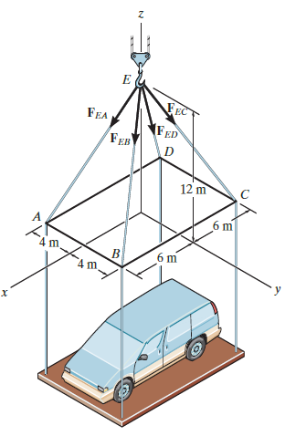
PROBLEM - 7
Q2. A Crane is used for lifting cars from the ground. At a given height we are told that the tension in each cable is 28 kN Find the resultant of all the tension forces. Also find the cartesian angle of the resultant vector. Using MATLAB
Get the weight of the car from the user and find out the tension in each cable assuming that the weight is along the –ve z axis. Also plot the variation of tension forces with the weight from 0 to given weight?
Get the tension on each cable from the user and draw the variation of resultant force wrt to tension?
Get the E z coordinate from the user and plot the variation of resultant wrt The coordinate?

Slide 51
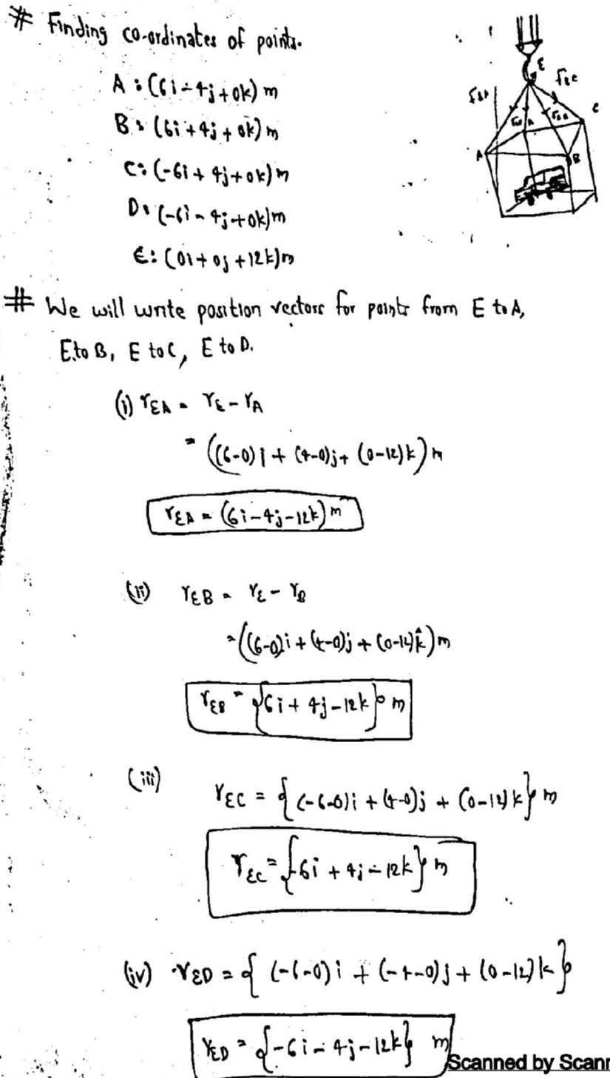
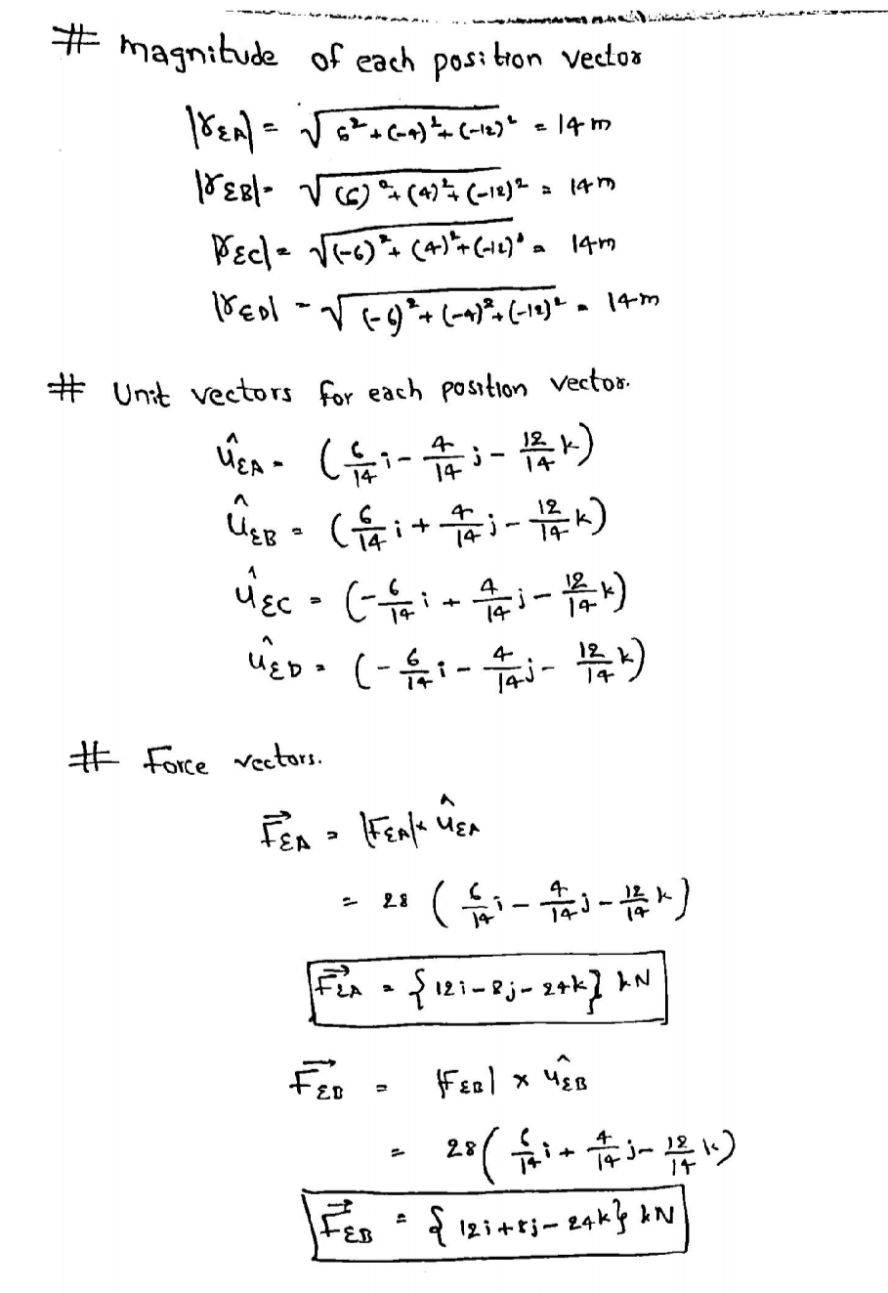
THEORITICAL CALCULATIONS

Slide 52
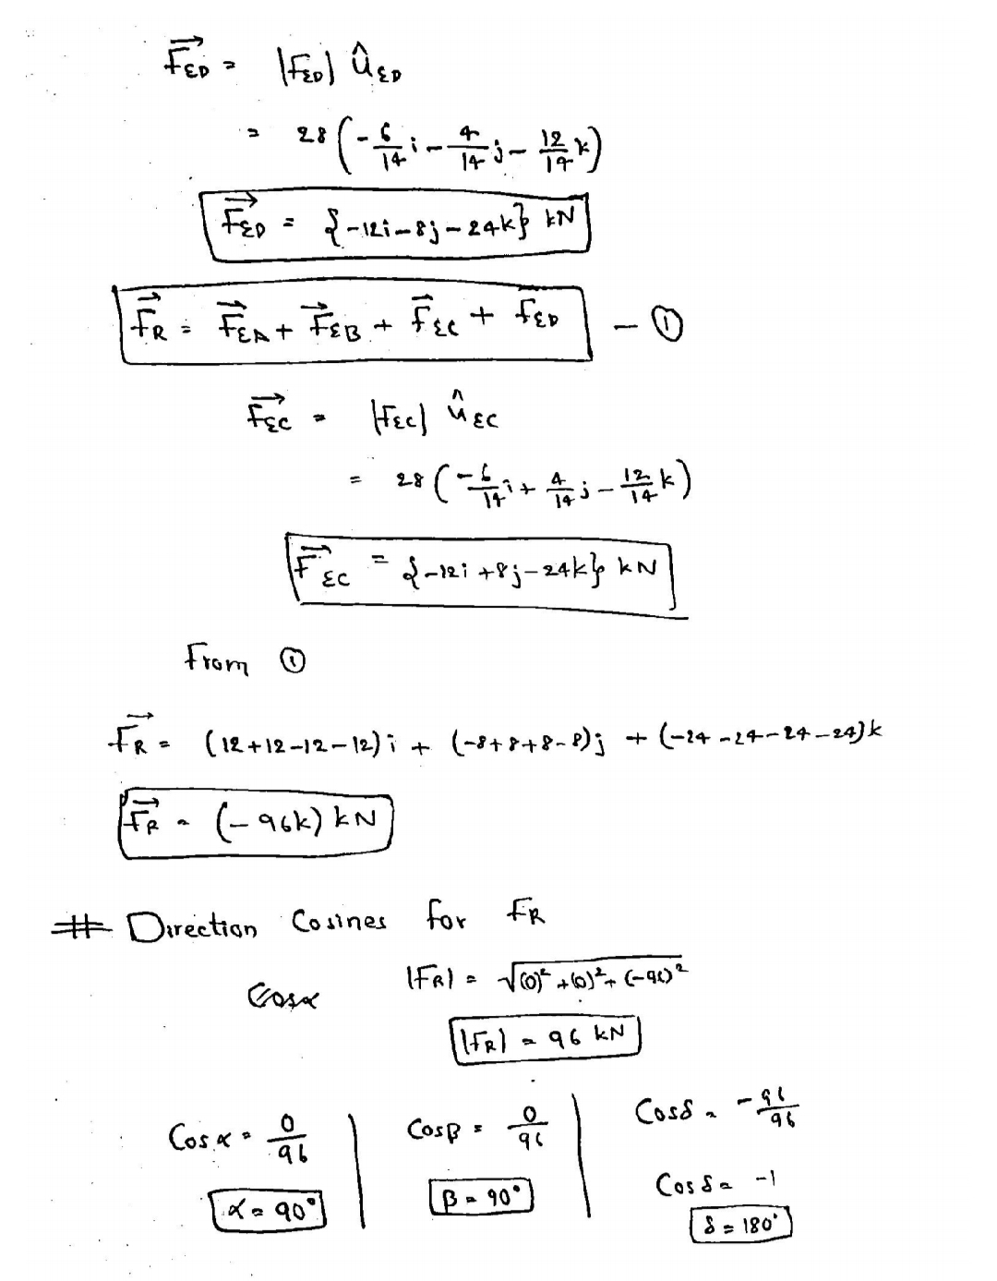

Slide 53
figure;
plot(x,T1)
title("VARIATION OF TENSION VS WEIGHT OF THE CAR IN kN ")
xlabel("Weight in kN")
ylabel("Tension in kN")
%QUESTION 2 MATLAB
T=input("Enter the breaking tension ");
disp("THE MAXIMUM LOAD SUPPORTED IS ");
W=norm(R)*T
r=1:T;
r2=1:T;
for o = 1:T
r2(1,o)=norm(R)*o;
end
figure;
plot(r,r2)
title("THE VARIATION OF MAXIMUM LOAD WITH WEIGHT")
ylabel("Weight in kN")
xlabel("Max tension in kN")
%QUESTION 3 MATLAB
q=input("Enter the z coordinate of E ");
T=input("Enter the breaking tension ");
a=1:q;
a1=1:q;
for i=1:q
D=[-6 -4 0];
C=[-6 4 0];
B=[6 4 0];
A=[6 -4 0];
E=[0 0 i];
AE=E-A;
BE=E-B;
CE=E-C;
DE=E-D;
AECAP=AE/norm(AE);
BECAP=BE/norm(BE);
CECAP=CE/norm(CE);
DECAP=DE/norm(DE);
R=AECAP+BECAP+CECAP+DECAP;
a1(1,i)= norm(R)*T;
MATLAB
%QUESTION 1 MATLAB CODE
D=[-6 -4 0];
C=[-6 4 0];
B=[6 4 0];
A=[6 -4 0];
q=12;
E=[0 0 q];
W= input("Enter the weight of the car ");
AE=E-A;
BE=E-B;
CE=E-C;
DE=E-D;
AECAP=AE/norm(AE);
disp("The cartesian angle wrt x axis for AE is ")
disp(acosd(AECAP(1,1)))
BECAP=BE/norm(BE);
disp("The cartesian angle wrt x axis for BE is ")
disp(acosd(BECAP(1,1)))
CECAP=CE/norm(CE);
disp("The cartesian angle wrt x axis for CE is ")
disp(acosd(CECAP(1,1)))
DECAP=DE/norm(DE);
disp("The cartesian angle wrt x axis for DE is ")
disp(acosd(DECAP(1,1)))
R=AECAP+BECAP+CECAP+DECAP;
T=W/norm(R);
disp("The tension in each cable is ")
disp(T)
x=1:W;
T1=1:W;
for i=1:W
T1(1,i)=W/i;
end

Slide 54
end
figure;
plot(a,a1)
title("THE VARIATION OF MAX LOAD WITH E COORDINATE")
xlabel("coordinate")
xlabel("Max tension in kN")
OUTPUT

Slide 55
CONCEPTS USED IN THE QUESTION
1.VECTORS IN 3D
2.VECTORS COMPONENTS OF VECTORS
3.FORCE EQUILIBRIUM
4.CARTESIAN ANGLE OF VECTORS

Slide 56


